Slide 1


Well-Aging
with Méthode Régénérante

Slide 2

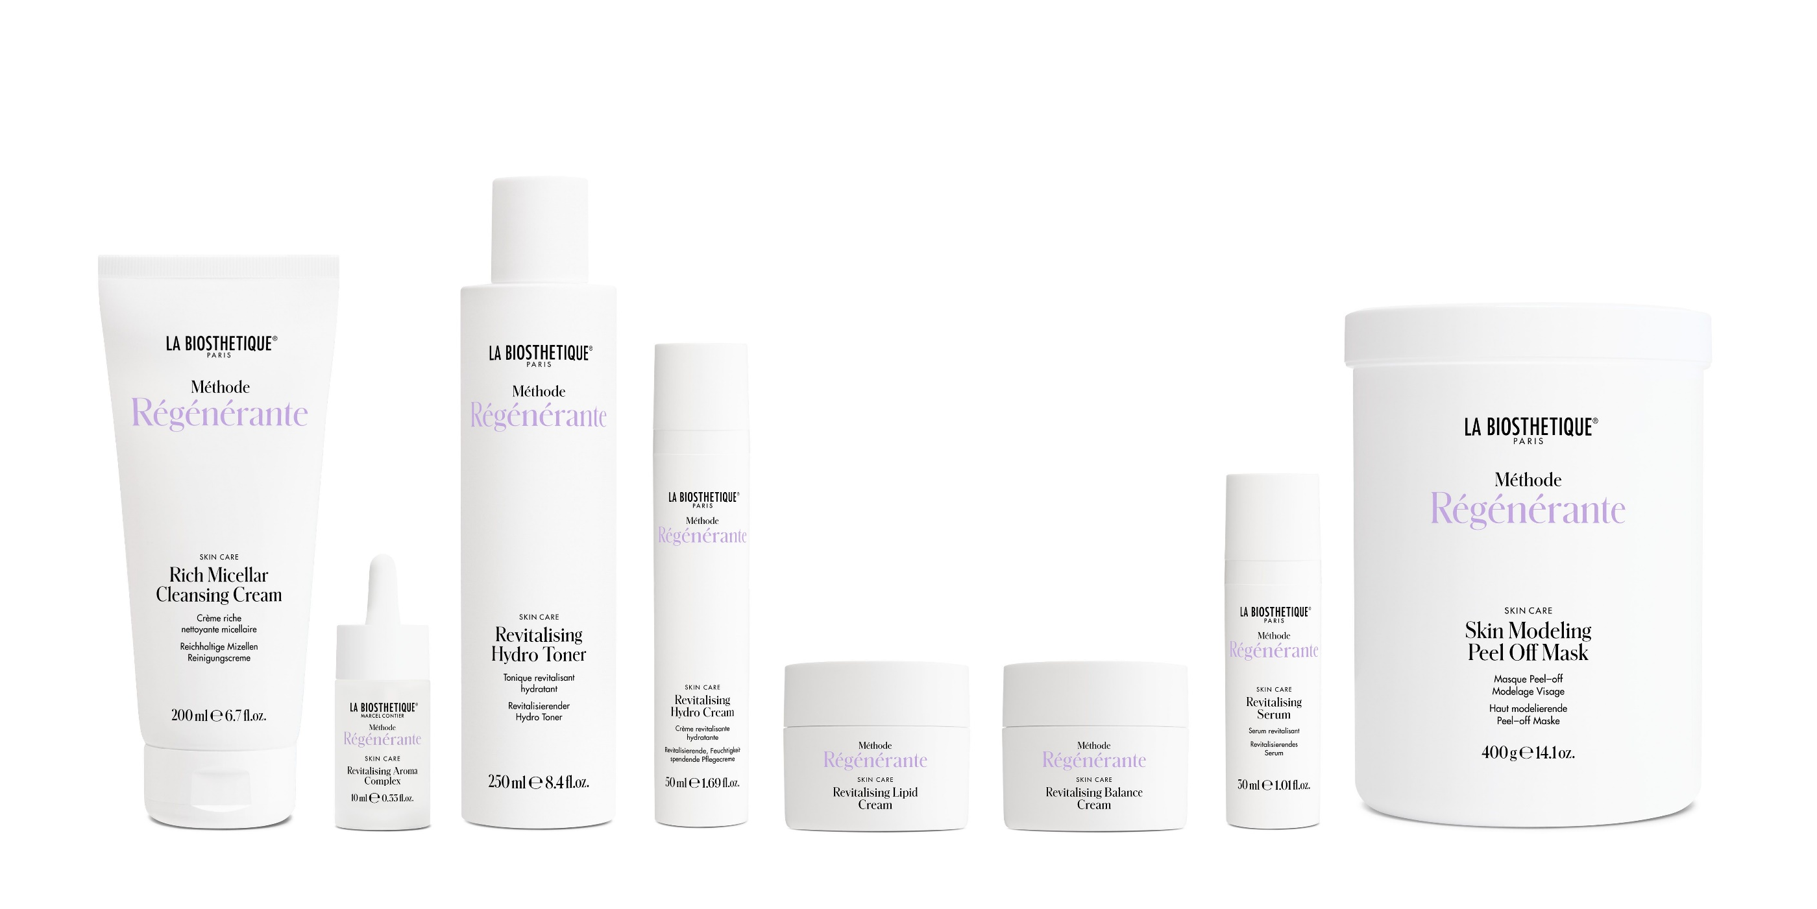
Notes:
The relaunch of M. Regenerante results from the fact that we want to bring our core competence to the fore; Marcel Contier already recognised the connection between scalp and skin in the 1950s and we want to bring this back together. That is why we have decided in favour of a joint active ingredient concept and a joint fragrance for M. Regenerante hair and skin.
We didn't change the fragrance in Skin Care because the hair area liked the Skin Care fragrance so much and adopted it, so the customer can find her beloved Menulphia fragrance again.
New packaging:
70% recycled material. Therefore slight colour differences between jar and lid. New: Hollow-walled jar, i.e. considerably less plastic.
Instead of a plastic cover, now use aluminium foil to hermetically seal the jar.
Antioxidants are one of the most important active ingredients for the health of our skin, hair and body. Both from the inside - we can all pay attention to this in our diet - and from the outside - with the right care.
Here we have opted for a very special, natural active ingredient: Edelweiss

Slide 3

The anti-ageing miracle!
Notes:
No other plant combines such an effective amount of protective active ingredients that protect the skin from ageing. Medicinal plant of the year 2019. As a very powerful anti-oxidant, it protects against free radicals and minimises the breakdown of hyaluronic acid.
This active ingredient has been specially encapsulated for us, making it particularly bioavailable and deeply effective for the skin. The encapsulation means that it is transported to the exact place in the skin where it develops its maximum effect.
You have to imagine the encapsulation method like a taxi. The taxi with the edelweiss for the skin delivers the active ingredient precisely to the fibroblasts, the cells that produce collagen. This is why we can also speak of revitalising the fibroblasts.

Slide 4
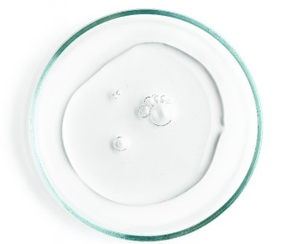
A multifunctional lipoamino acid
Notes:
Proven active ingredients have been retained, such as plant-based lipoamino acid, to combat age-accelerating micro-inflammation of the skin. The skin seethes beneath the surface, so to speak. This is also known as inflammaging. This refers to the increase in inflammation-promoting messenger substances and the skin's inability to cope with free radicals,
Lipoamino acid improves the energy performance of the skin cells because it significantly reduces the inflammatory processes in the skin. Methode Regenerante - this keeps the skin looking young and vital for longer because the skin is under less stress in depth and can regenerate itself.

Slide 5
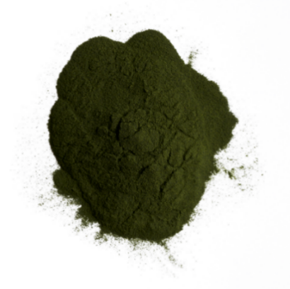
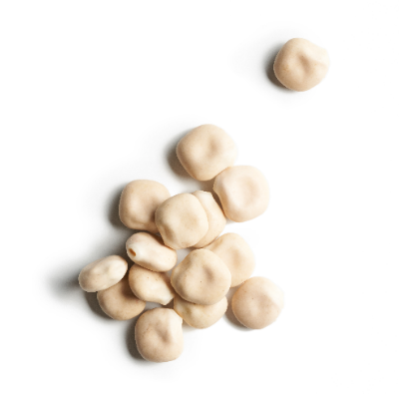
White lupin and microalgae
Notes:
Extracts from white lupine and microalgae. They stimulate cell metabolism and increase skin moisture. They are rich in minerals, vitamins and essential fatty acids. They have a detoxifying effect on the cells.

Slide 6
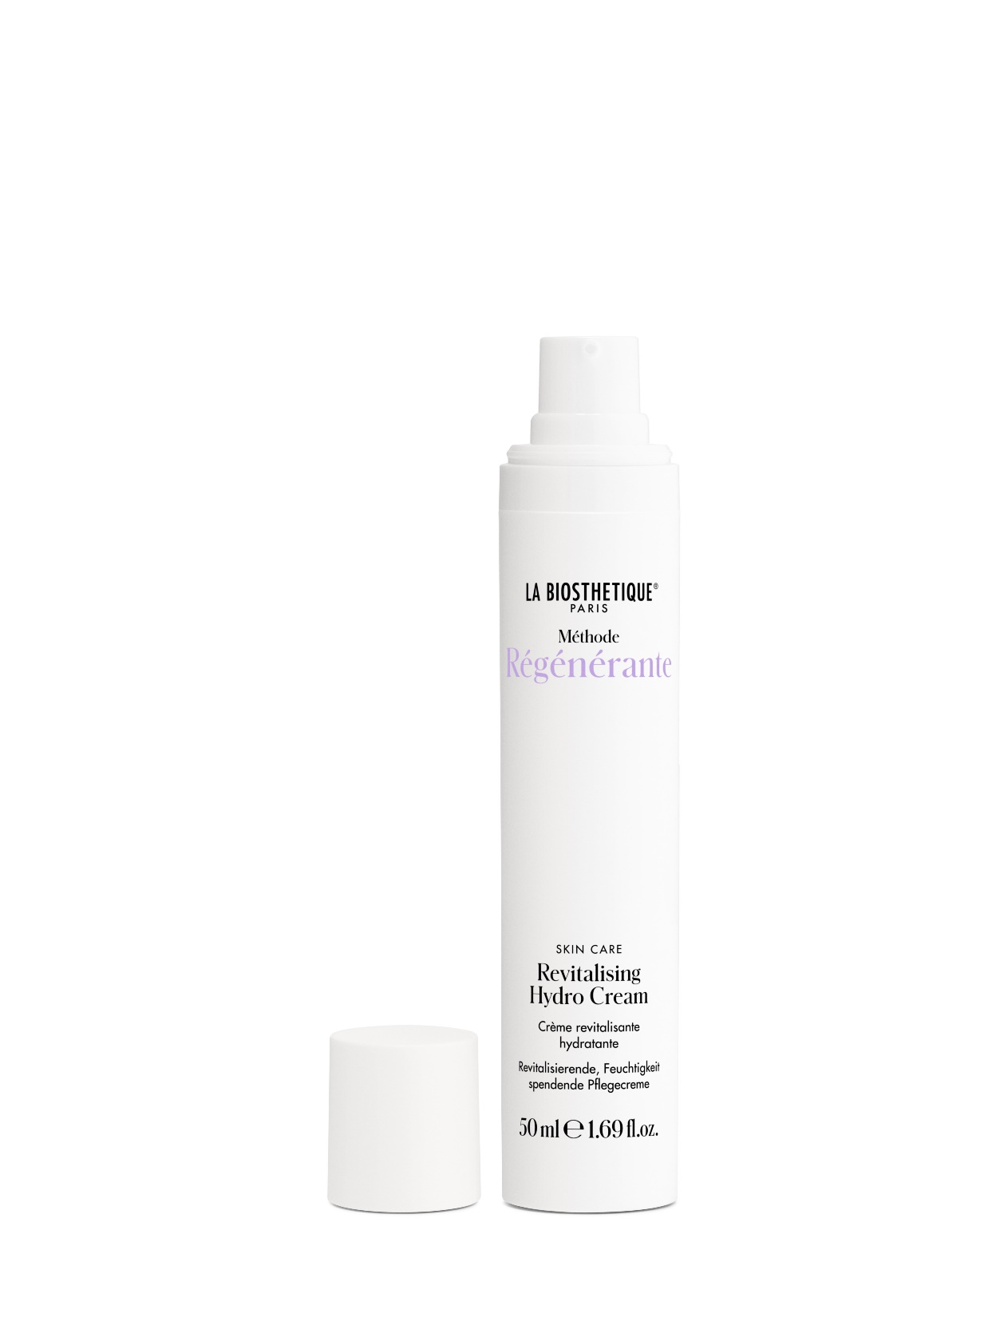
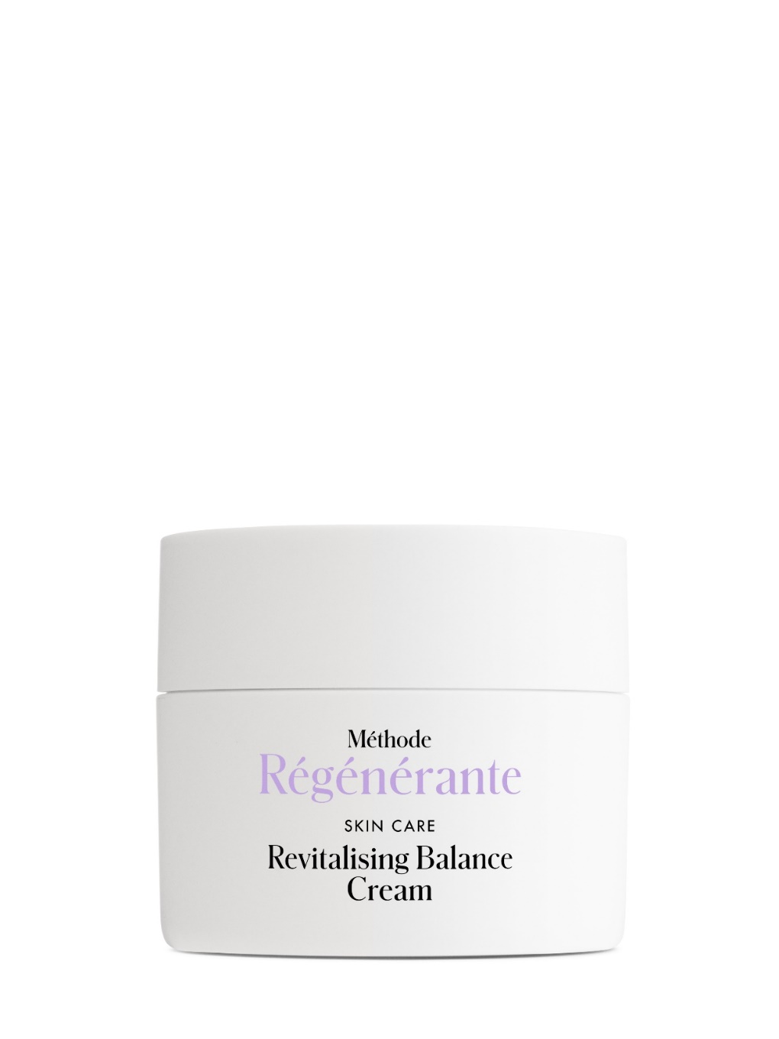
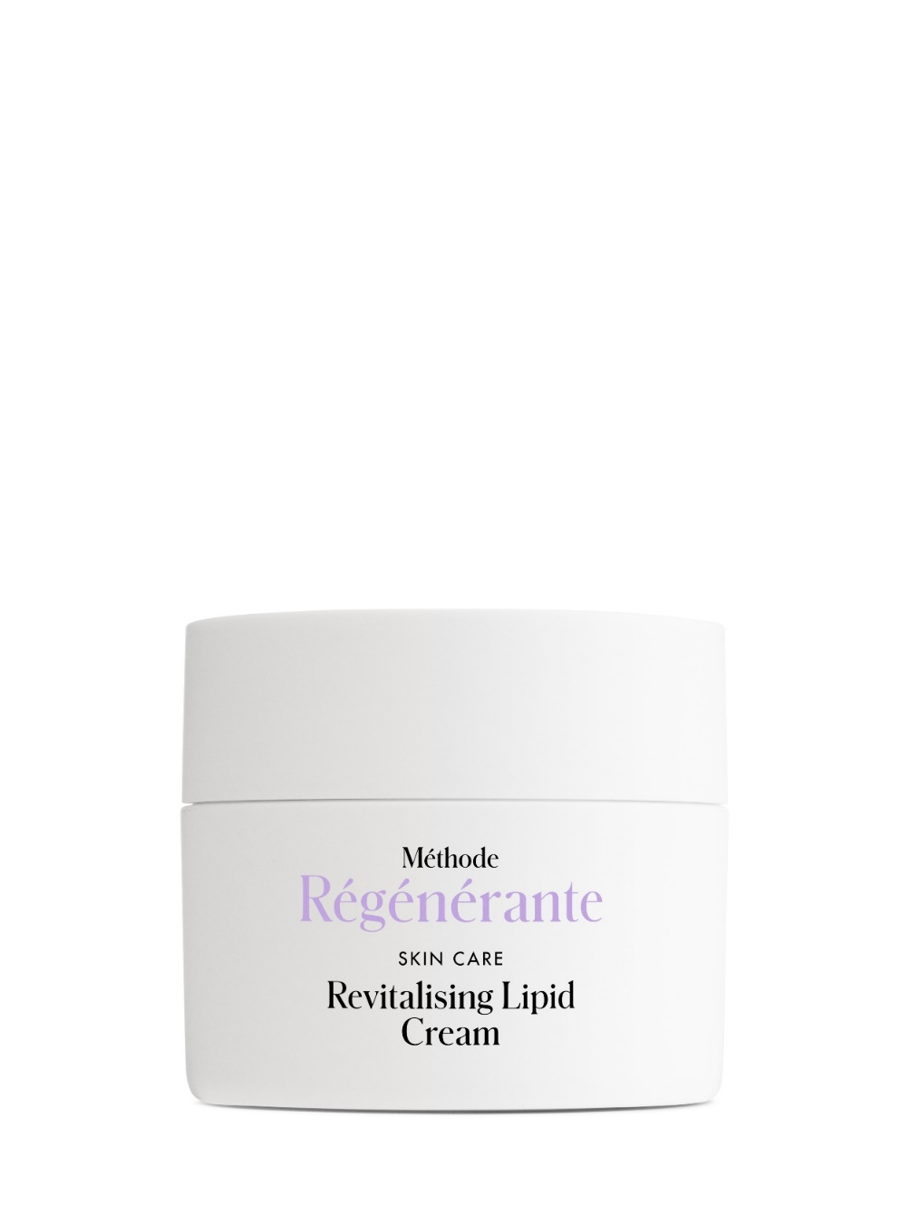
What creams are available?
Notes:
Revitalising Balance Cream as the successor to Menulphia. for slightly dry to combination skin.
Revitalising Lipid Cream. It combines the well-known Menulphia Riche and Creme Vitalitè in one product. It cares for very dry skin, yet is easily absorbed. This is made possible by the additional vitamin F from safflower oil - highly concentrated essential polyunsaturated fatty acids that the body cannot produce itself.
With Revitalising Hydro Cream, we have chosen a lighter, slightly more fluid texture that offers plenty of moisture and still provides the skin with soothing care throughout the day. In addition, a dispenser also offers the possibility to advise Revitalising Hydro Cream not only for women but also for men's skin.

Slide 7
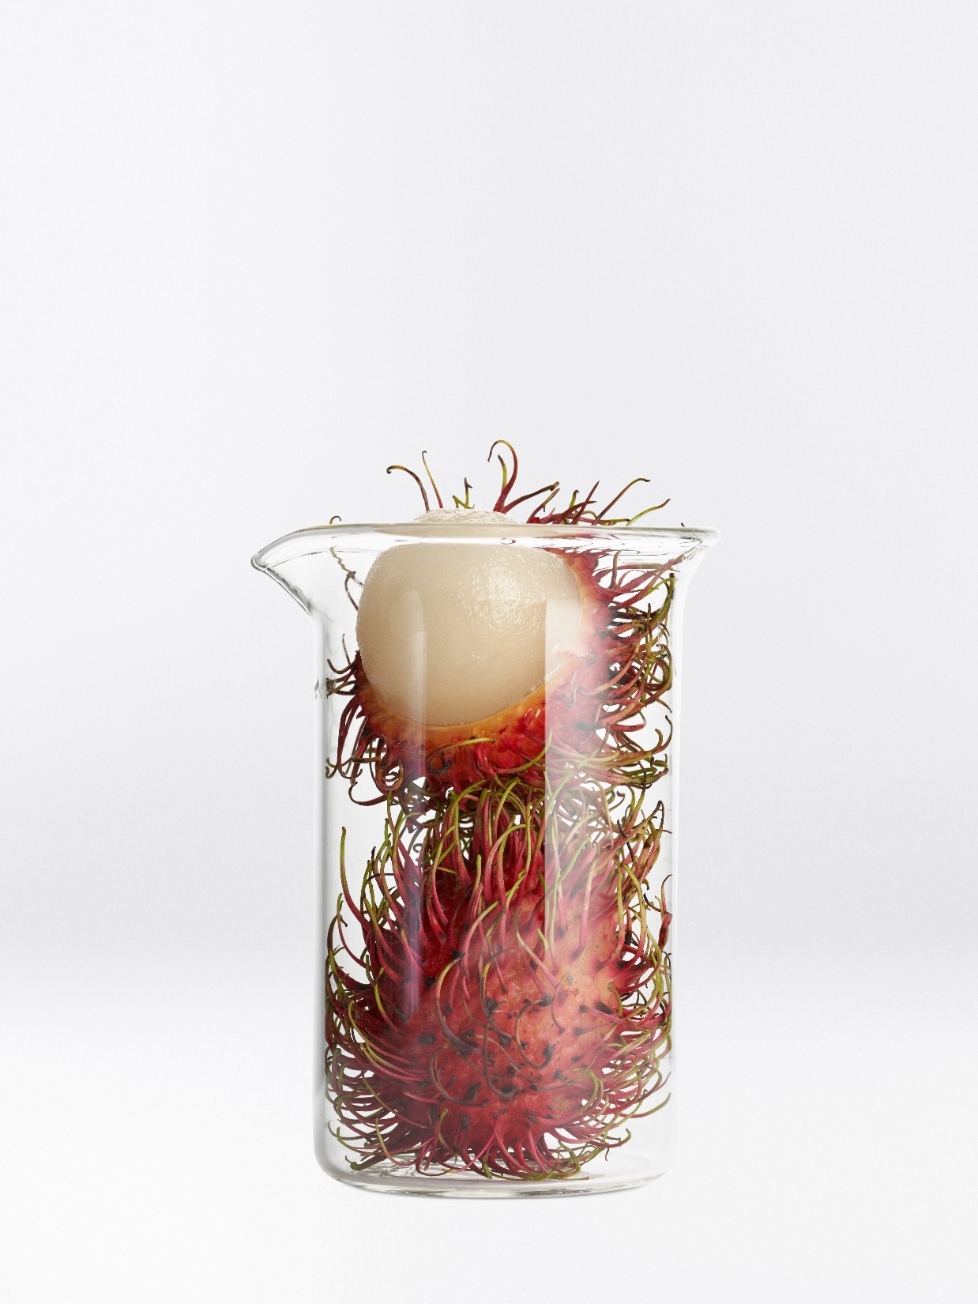
Rambutan
Strengthens the epidermis
Protects against dehydration
Increases ATP formation and new cell energy
Notes:
a completely new plant-based moisturising active ingredient from the peel of the Asian rambutan is found here with multiple effects,
Similar to lychee. Hydrates through 3 mechanisms of action: strengthening the horny layer, increasing ATP formation, supplying the cells with new energy
Why no eye care in the new Regenerante method?

Slide 8
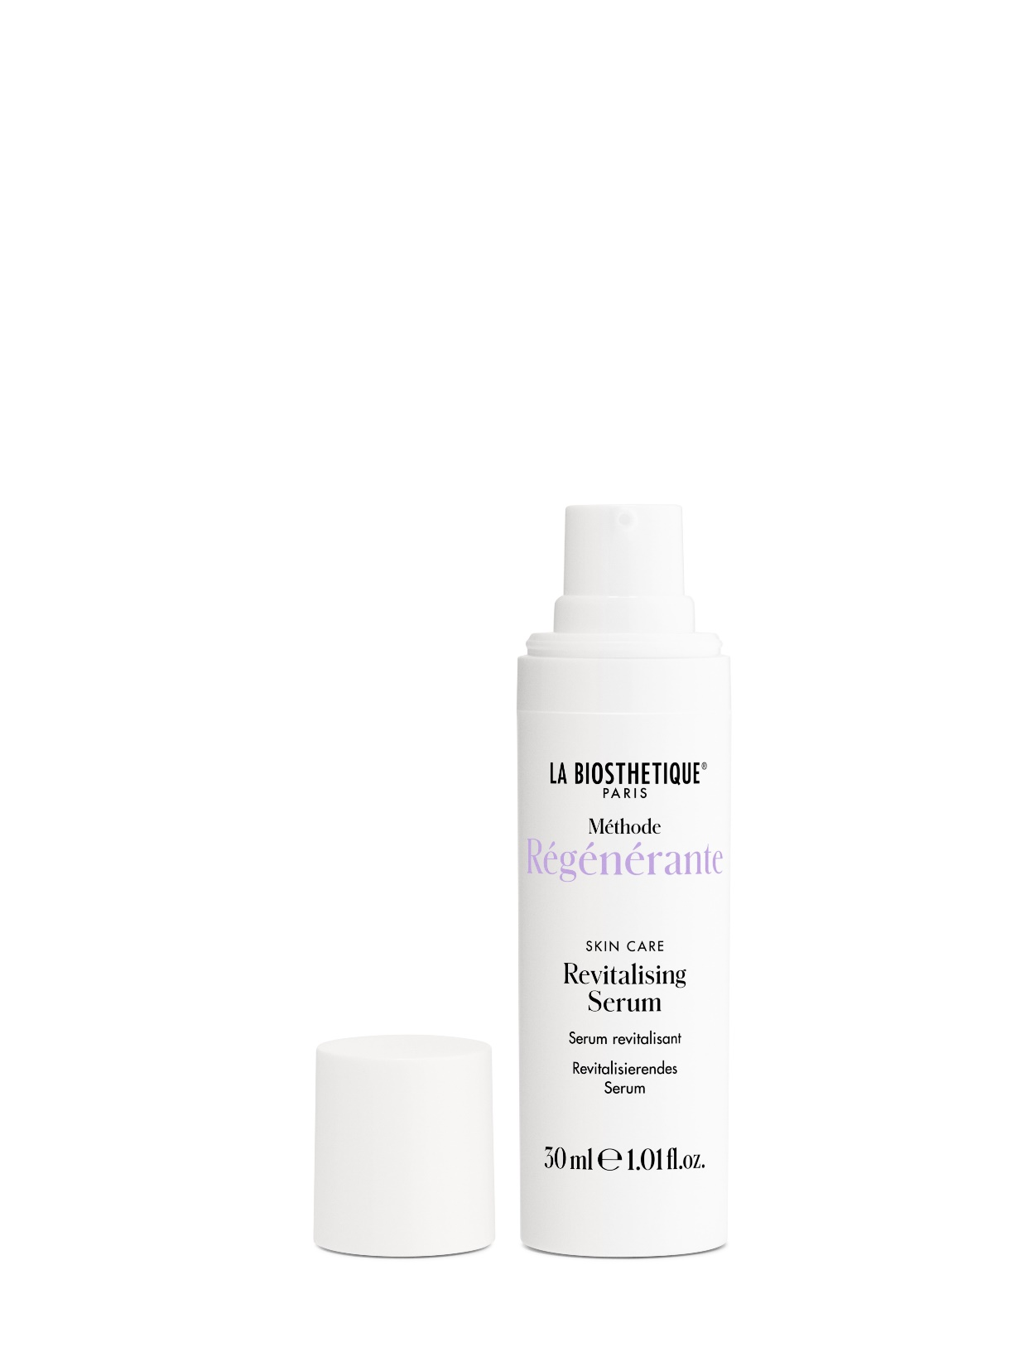
The Phyto-Retinol serum for face and eyes
No potential irritant
Refines skin texture
Can be used twice a day
Stimulates collagen production
Face and eyes
Also for skin blemishes
Notes:
The most common way to start anti-ageing care is with eye care. A serum that is ideal for all skin types and for the face and eyes alike.
The serum is a perfect door opener for me in the consultation if my customer is still using another skin care product, because with this product I can be sure that she is not using anything like it yet and the great thing is that she can combine it wonderfully with her existing skin care.
Revitalising Serum refines and improves every skin texture. Ideal for long-term use. Apply daily to toned skin, even twice a day.
Very well tolerated, even by sensitive skin. Stimulates collagen formation.
Revitalising Serum can be used in combination with Niacin + Vitamin C Serum from Dermosthetique or alternately (morning/evening) for skin with a tendency to blemishes and rosacea.
As a positive side effect: can reduce skin discolouration and pigmentation spots through a gentle regulating effect on melanin synthesis - ideal in combination with Illuminating Concentrate Vitamin C and Niacin from Dermosthetique

Slide 9
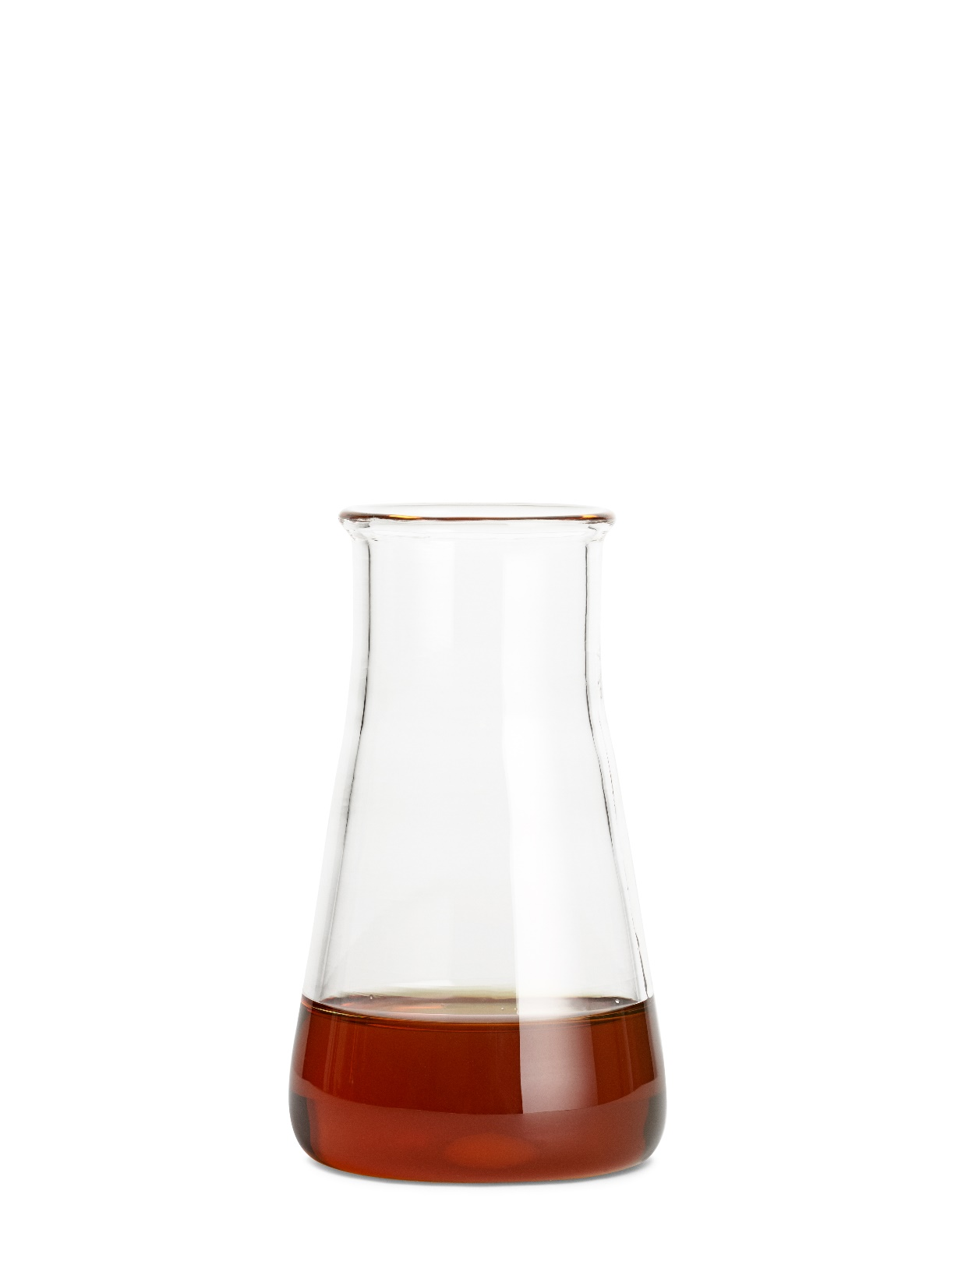
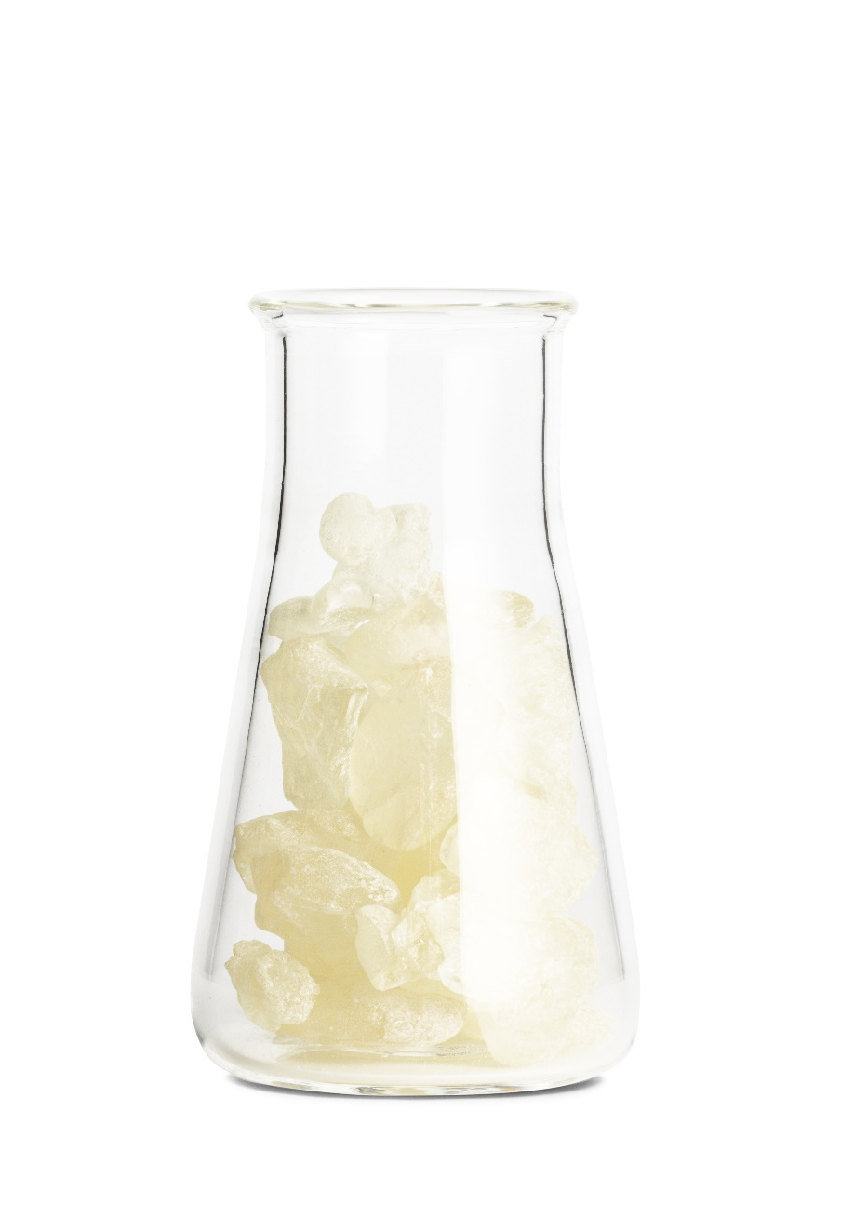
The main active ingredients in Revitalising Serum
Bakuchiol
Pistacia Resin
Notes:
Is bakuchiol as effective as retinol?
Bakuchiol is actually the better choice for people with sensitive skin. In a clinical study, the effect of these plant-based active ingredients was even more intensive than with retinol and without any undesirable side effects.
Bakuchiol is the herbal alternative to retinol. Very skin-friendly, can also be used during pregnancy or breastfeeding. Both active ingredients have a similar effect, but Bakuchiol has a different structure and is much better tolerated by the skin.
It is also known as bio-retinol or phyto-retinol and is a powerful antioxidant that helps to boost collagen synthesis by actively influencing cell damage processes.
Pistacia resin as the 2nd active ingredient increases the body's own retinol level because it inhibits the breakdown in the skin via enzymes. As a result, the retinoic acid level in the skin can be maintained.
Give your customers the additional tip of consciously including the vitamin precursor of vitamin A, beta-carotene, in their diet, e.g. eating more red and orange vegetables and fruit or the new food supplements from La biosthetique are a great addition to this.

Slide 10
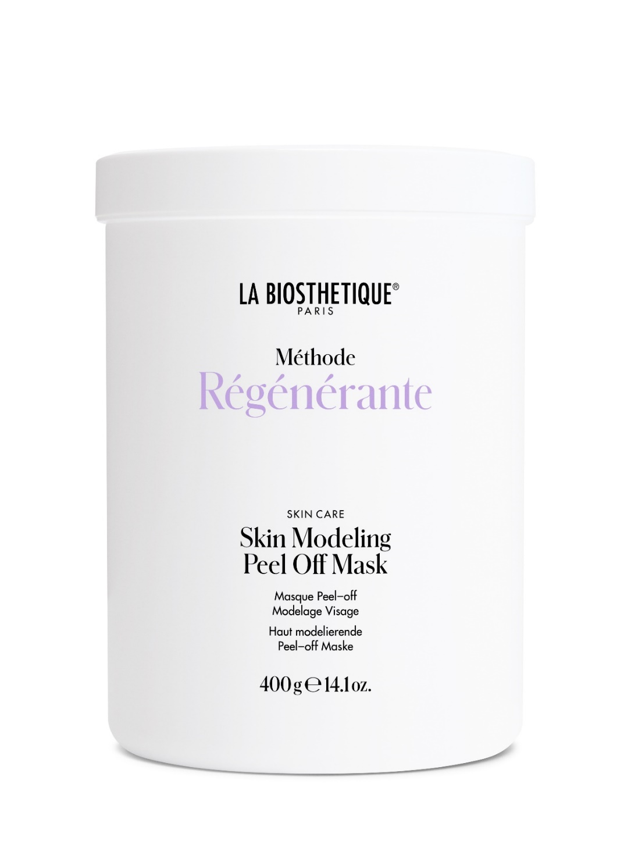
Skin Modelling Peel Off Mask
Collagen booster
Neutralises free radicals
Tightening, clarifying
Notes:
Skin Modelling Peel Off Mask is the multifunctional modelling mask as we already know it from Masque Mer et Beauté.
The mask: a combination of red algae, also known as "calcium algae", and sea salt with a high mineral and trace element content.
The professional intensive treatment that instantly makes the skin look more radiant. With just one application. A mask for all skin types!
All areas of the face and body can be modelled with it.
10 - 20 min application time
Also as a micro-zone treatment For reddened cheeks, eye area, mouth region, problem areas on the body.
For all skin types, also ideal as a post-treatment after a cleansing treatment to soothe the skin

Slide 11
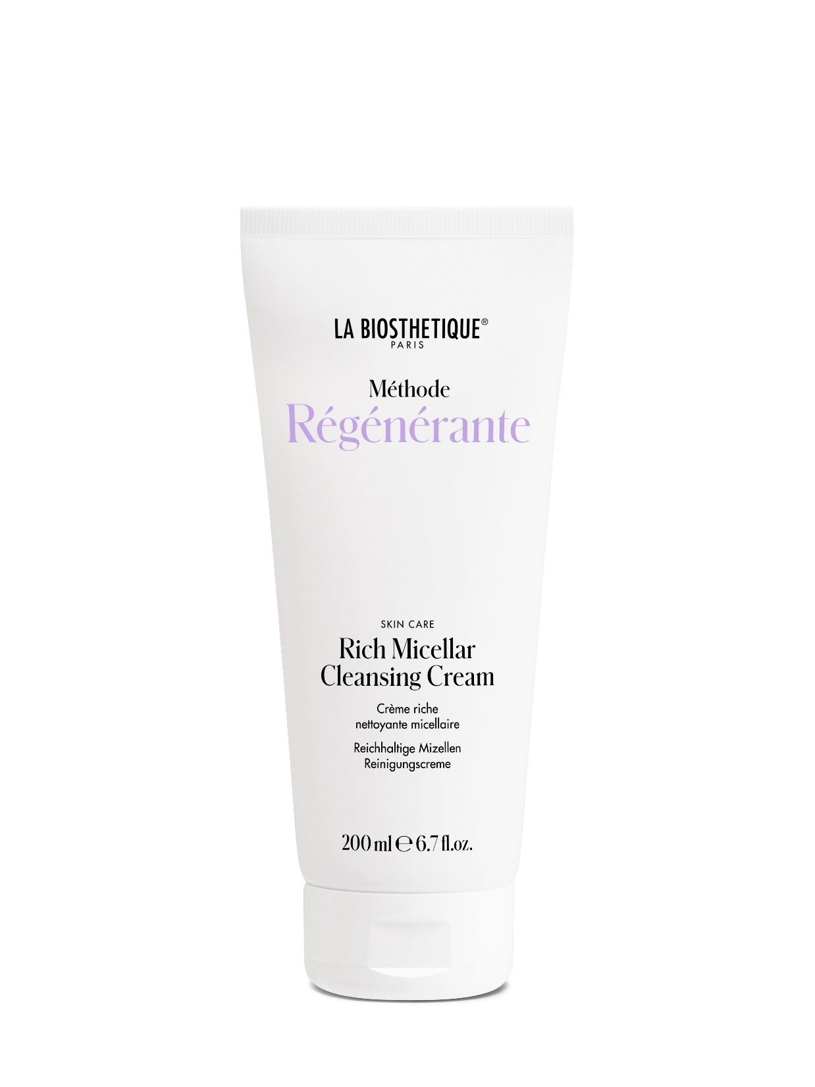
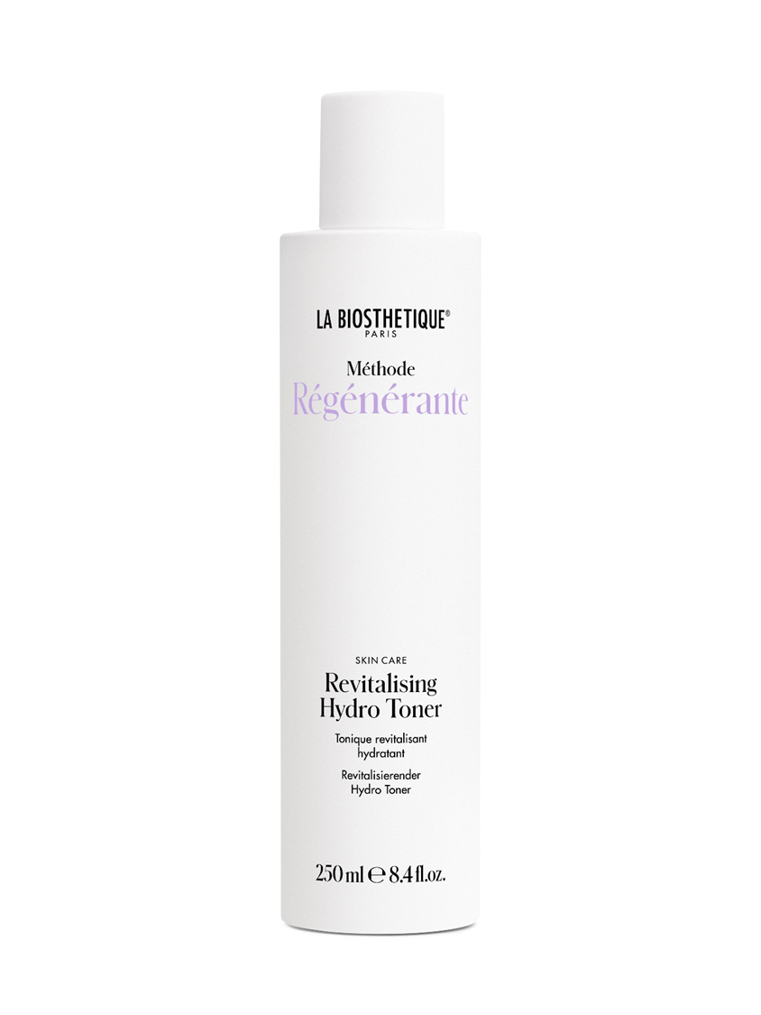
Cleansing and toner
Skin-identical moisturising building blocks
White lupine
Green microalgae
100 % natural sugar building blocks
Glycolipids
Notes:
Rich Micellar Cleansing Cream contains glycolipids derived from 100 % natural sugar building blocks, which form micelles.
These micelles are active cleansing molecules that attract and bind to dirt and make-up like magnets. The cleansing cream removes both grease and water-soluble particles.
This cleansing cream is perfect for anyone who likes a creamy cleanser but still wants their skin to feel clean.
No feeling of tightness on the skin. Super compatible for sensitive skin and is a very effective cleanser, very economical to use.
And also with the Revitalising Hydro Toner: here you can immediately feel the rich moisture. Skin-identical moisturising components strengthen the skin barrier, as does an active complex of green microalgae and white lupins.

Slide 12
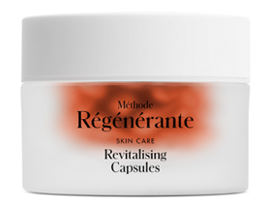
Revitalising care oil
Gamma-linolenic acid
Beta carotene
Winged kelp
Available from autumn
Notes:
The new Revitalising Capsules still contain the tried-and-tested borage facial oil supplemented with beta-carotene, macadamia nut oil and seaweed extract. Revitalises and protects down to cellular level.
The intensively nourished skin is finer-pored, firmer and silky smooth, just the way our customers love it.
As before, the Revitalising Capsules are also preservative-free.

Slide 13
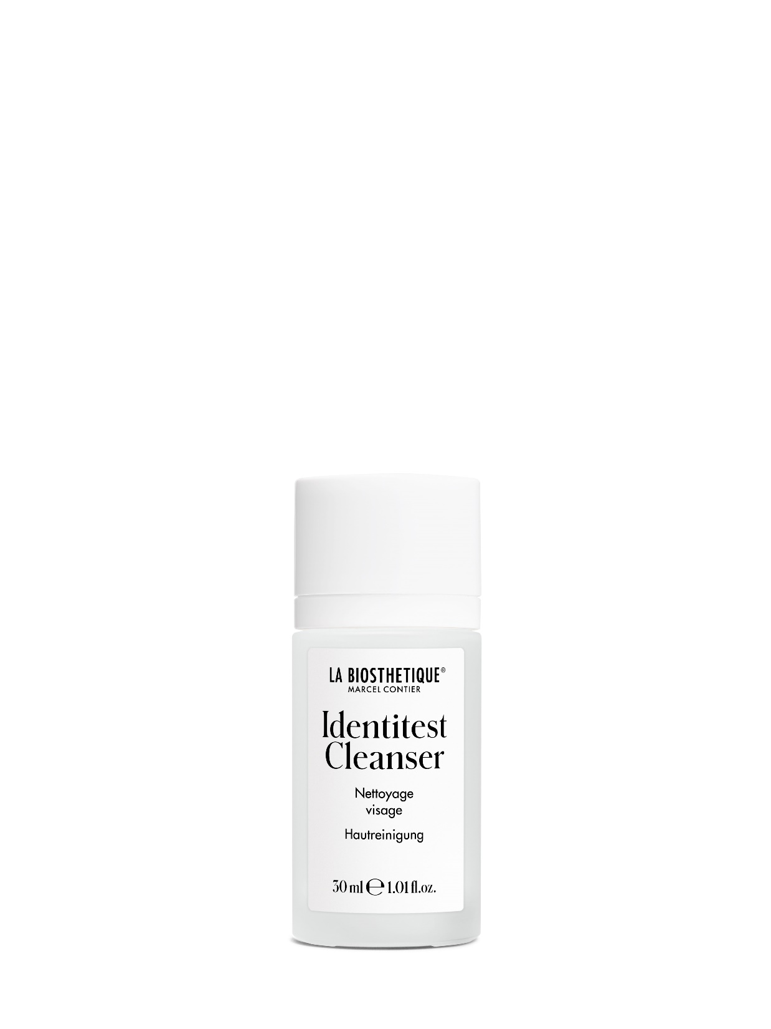
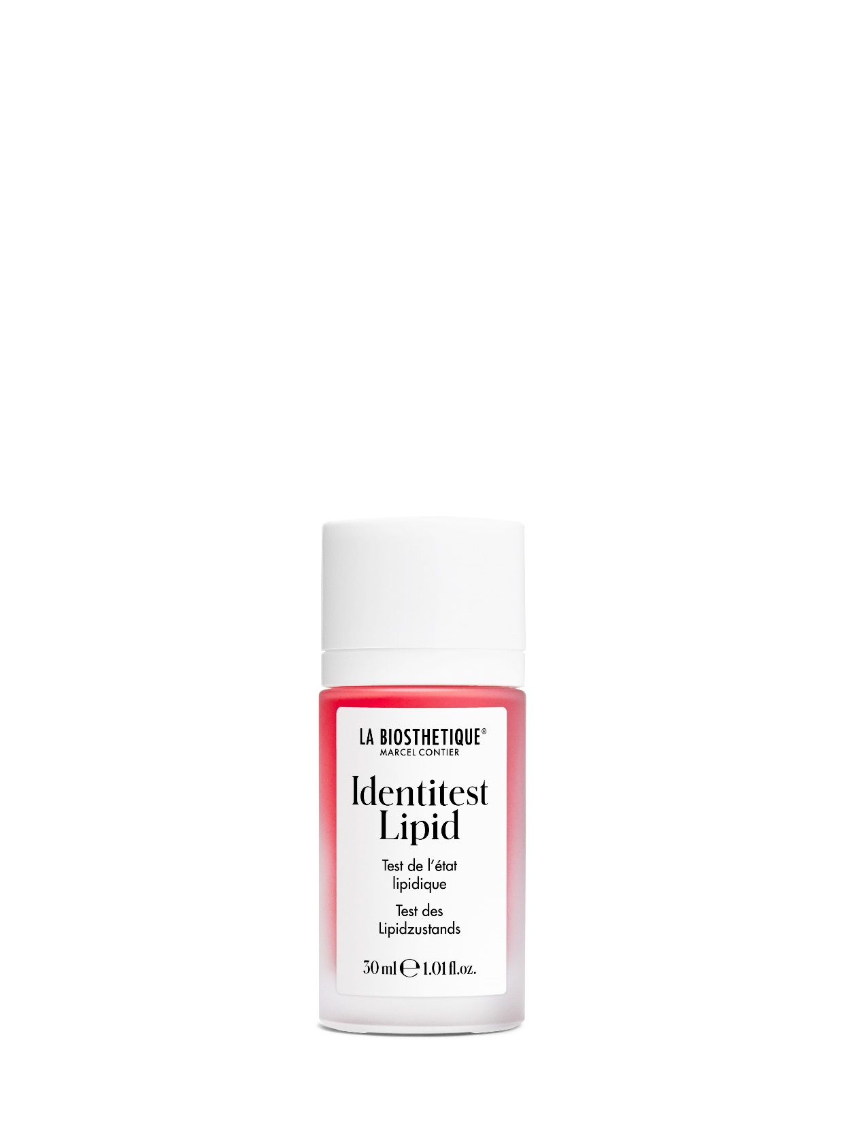
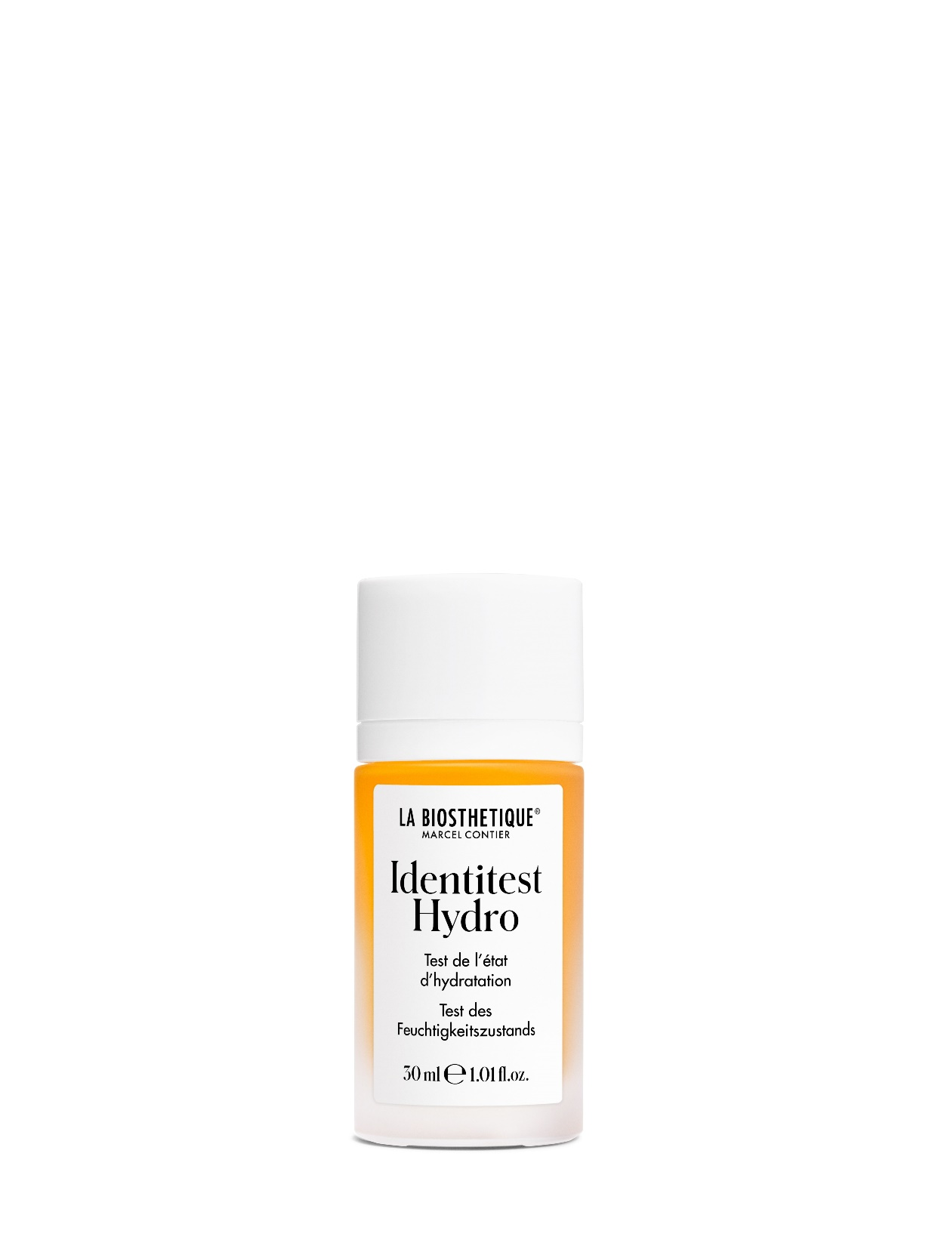
The new Identitest
Notes:
The cleanser is the current R1 and is used as before. The names Lipid and Hydrotest make it easier for customers to understand what we are testing and, as before, we have our colour dots on the back to show the result.

Slide 14
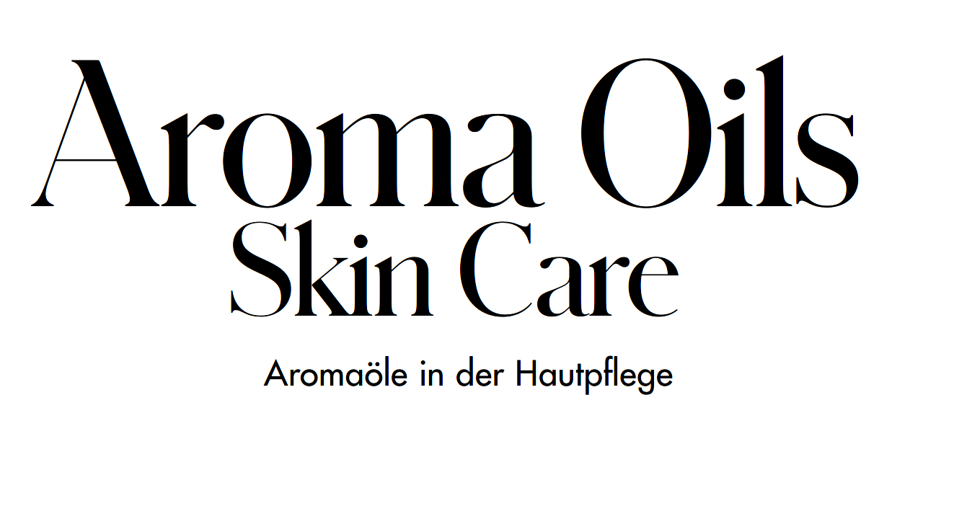
Notes:
Claudia: a new world of skin care flavours? Perhaps you are wondering: Is aromatherapy still up to date?
Stop screen presi.
Inge: Aromatherapy is still a wonderful topic for skin care and rounds off the methods at La Biosthétique simply and sensibly, but also in the sense of the original holistic method concept.
Claudia: And essential oils contain the concentrated powers of nature. The fragrant plant essences act on the brain via the nose and directly on the skin via their molecules.
Many people, especially women, are under constant stress - although it is not so much the amount of work that women have to do, but the constant feeling of being responsible for everything that often puts a lot of strain on them. Aromaoils from La Biosthetique can help you to be more mindful of yourself and mood-enhancing messenger substances help with nervousness and lack of energy.
Bergamot is considered one of the most important oils for people, against worries, restlessness or mood blues.
Inge: What's new is that we now also have ready-to-use flavour oils for the face

Slide 15
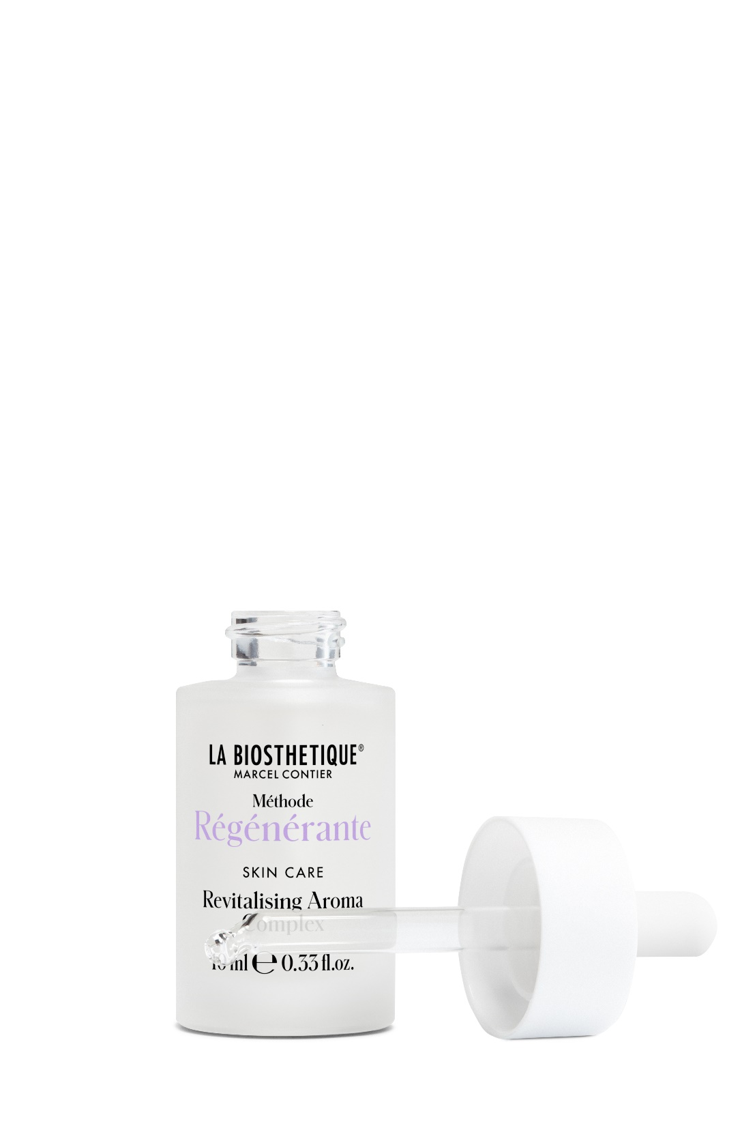
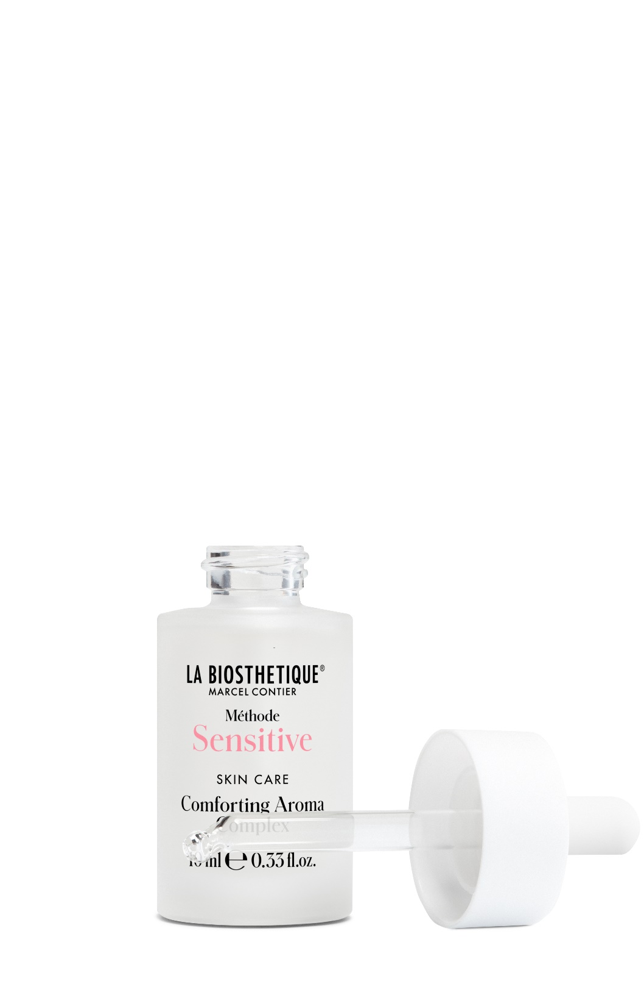
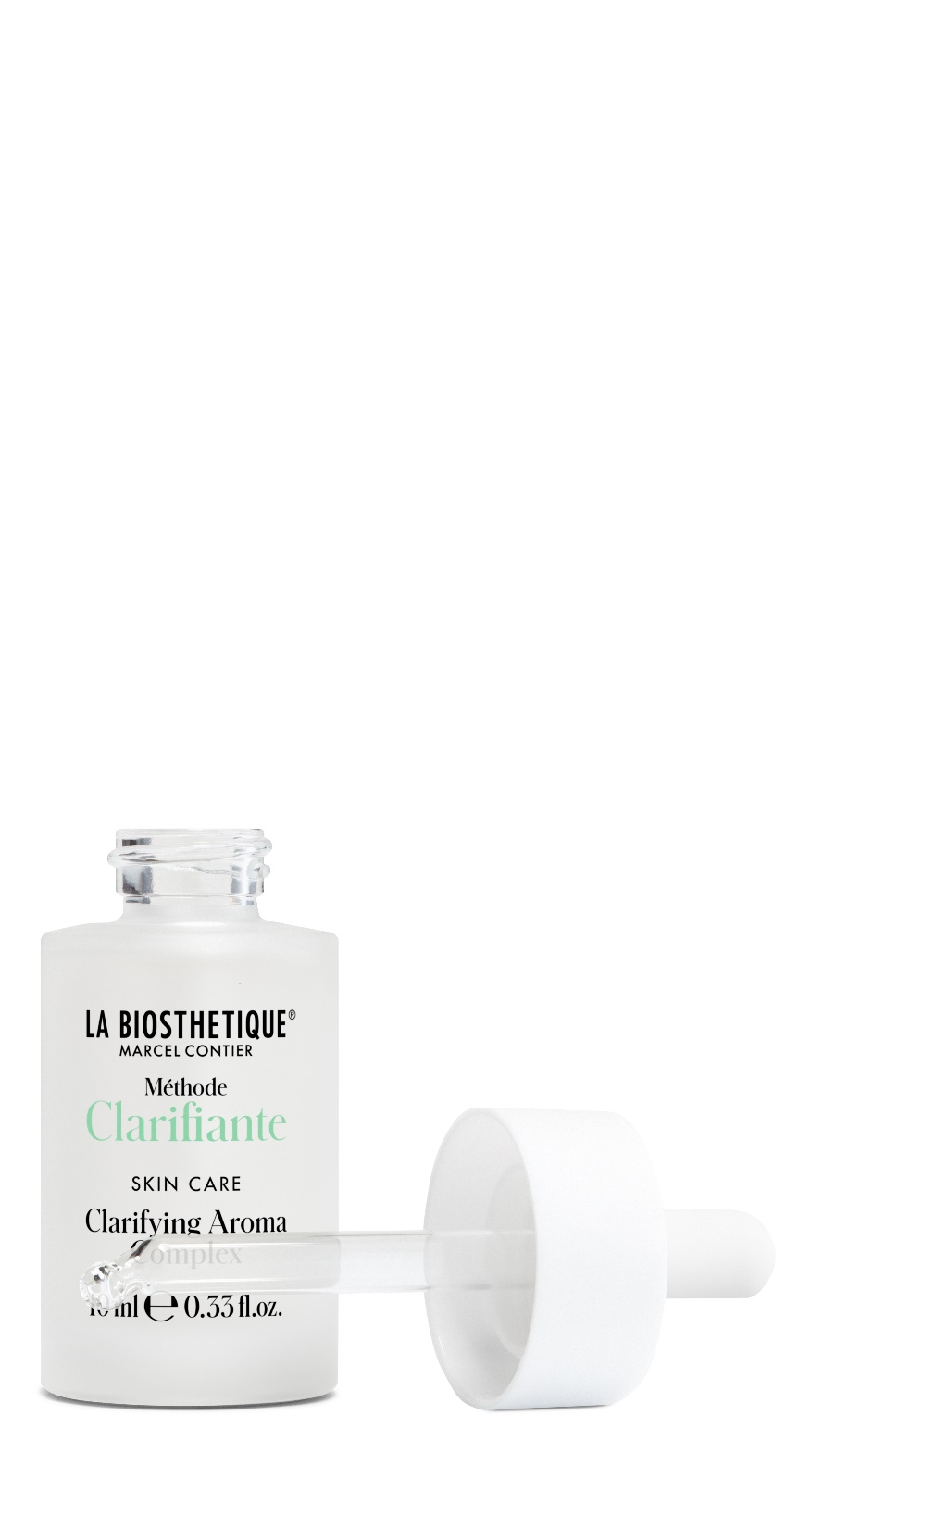
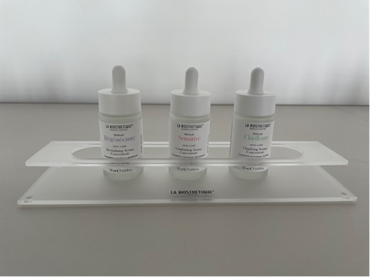
The new world of skin care aromas
Aroma Complex
10 ml - retail product
Ready-to-use oils
Notes:
The special feature is the simple application of the now ready-to-use 10 ml Aroma Complexe. Put a few drops in your hands and then spread it over your face.
The Aroma Complexes contain natural fatty acid esters that are quickly absorbed by the skin and leave no greasy shine.

Slide 16
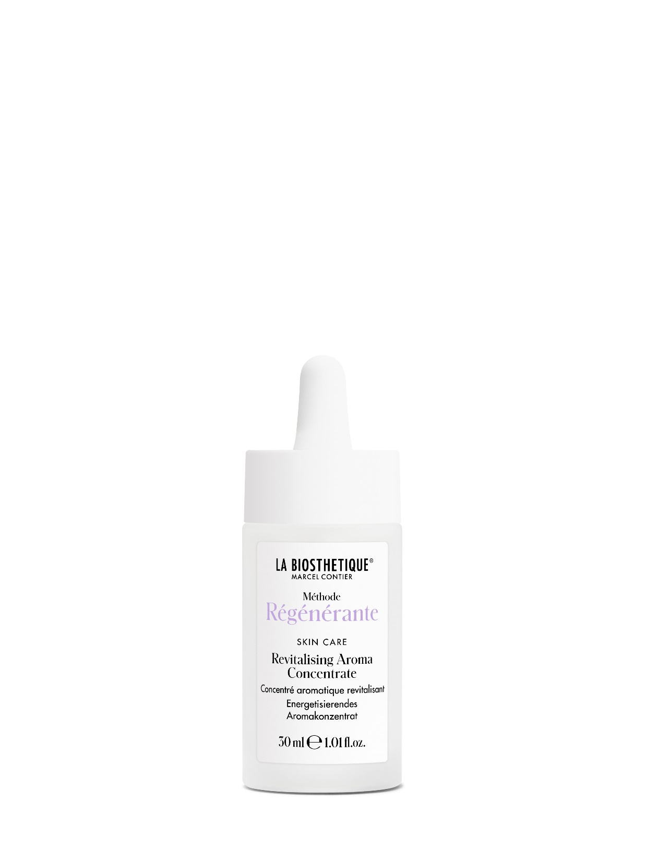
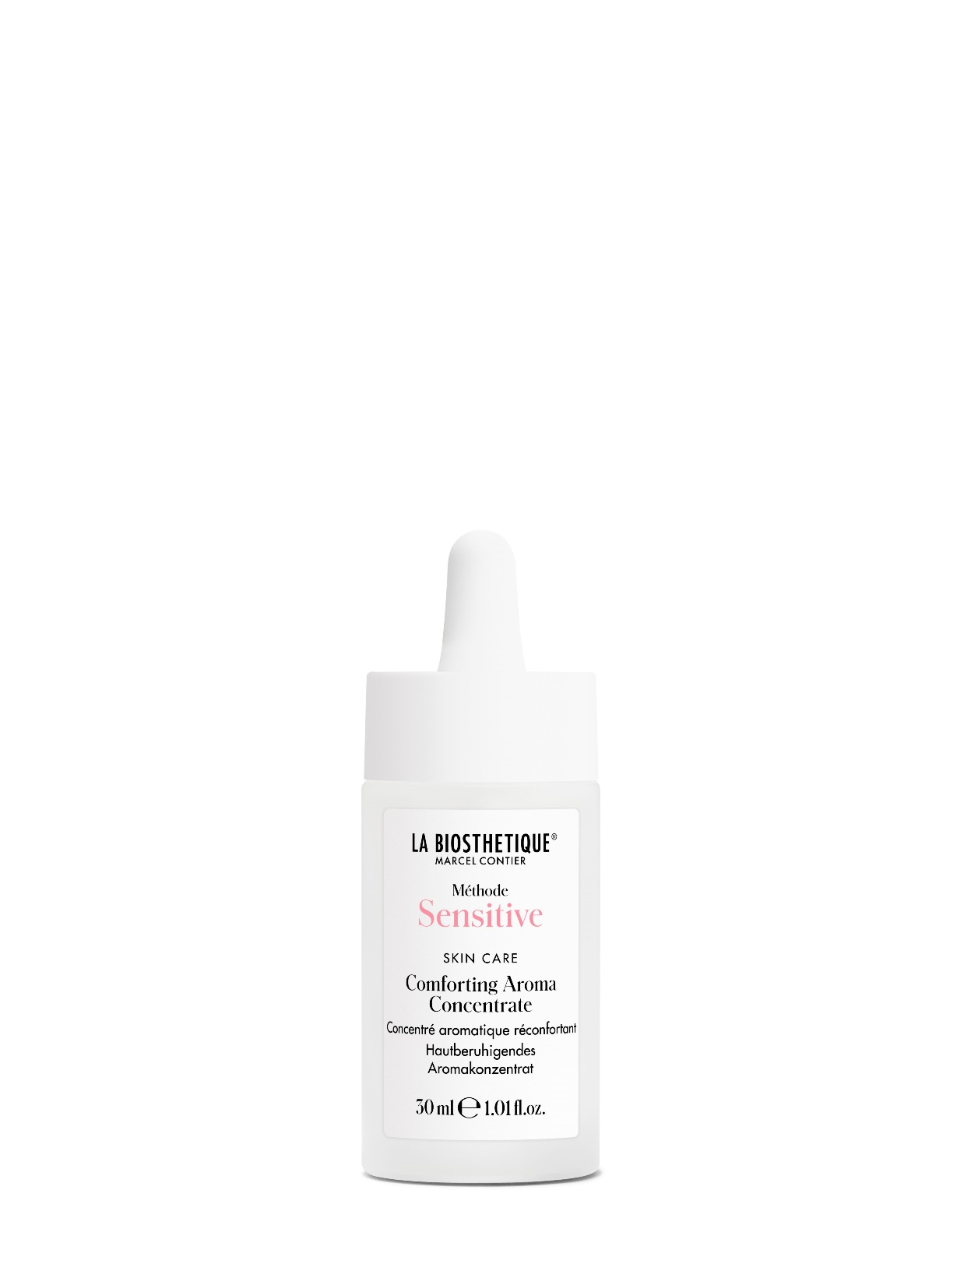
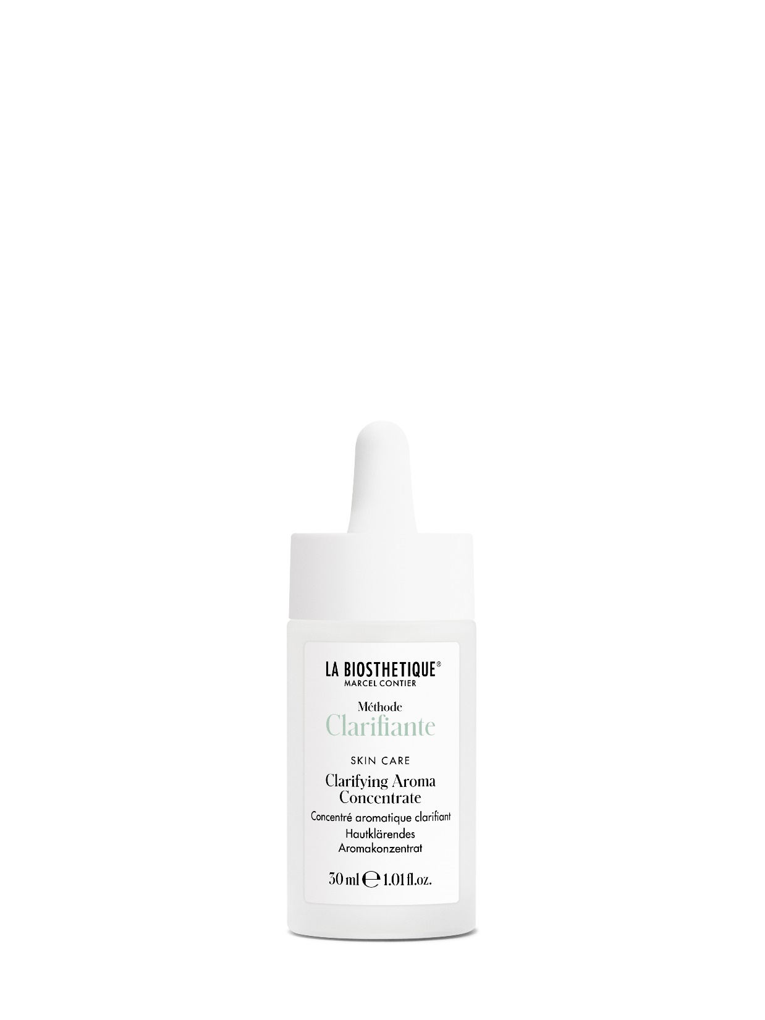
The new world of skin care aromas
Aroma Concentrate
30 ml - professional product
Needs to be diluted in water
Notes:
The 30 ml concentrates in the cabinet have been retained so that all the usual applications are possible.
.

Slide 17
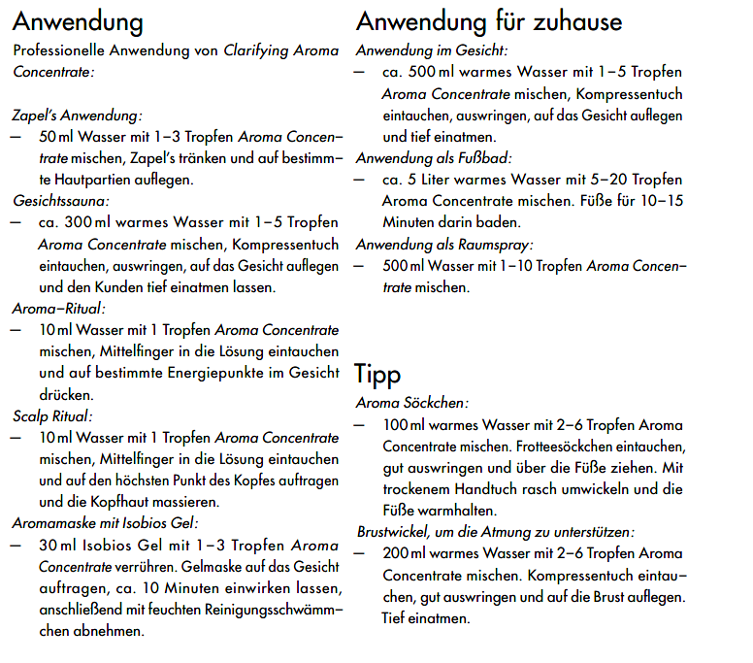
Application of the Aroma Concentrates
Zapel's
Face compress
Aroma Ritual
Aroma mask
Face cleanse
Footbath
Aroma socks
Notes:
And if one or two customers want to take a foot bath, there's nothing stopping us from giving them the Aroma Concentrate to take home with them. That's why the price list also includes the retail price.
Precise instructions for the dilutions can be found in the Aroma Concentrate Compendium.

Slide 18
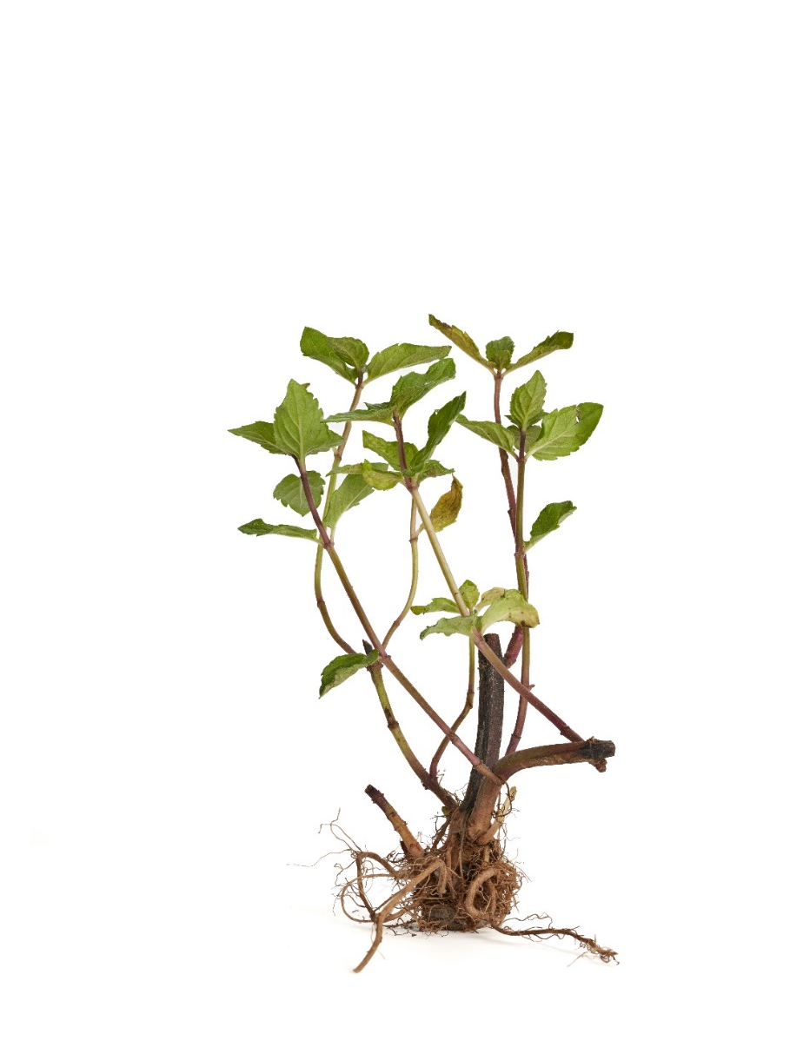
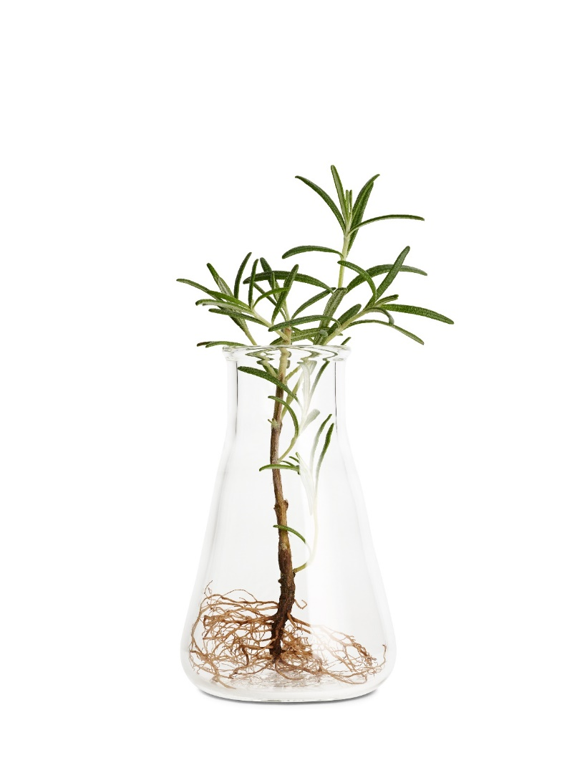
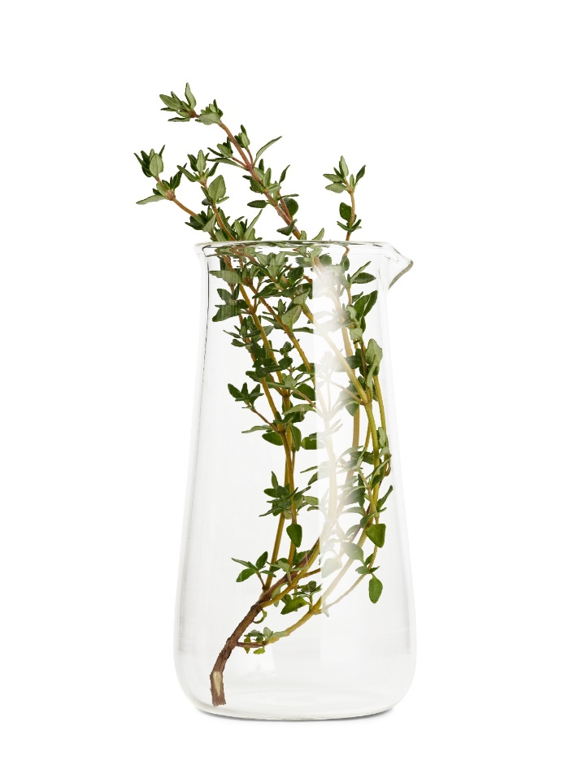
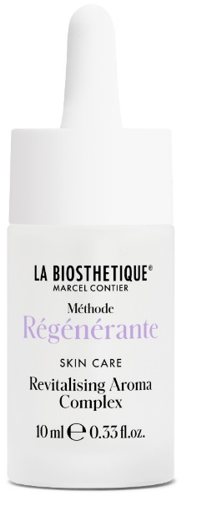
Revitalising Aroma Oils
Vitalising
for body & mind
Thyme
Rosemary
Peppermint
Notes:
The mode of action of Complexe and Concentrate is the same, only the application differs.
The Revitalising Aroma Oils contain: Thyme, Rosemary, Peppermint
Has a vitalising effect for a fresh complexion, tightens the tissue, has a strengthening effect, is very refreshing and stimulates the circulation.
Effect through inhalation: energises, promotes regeneration, helps to increase concentration. An ideal driving oil and for all hard-working people.

Slide 19
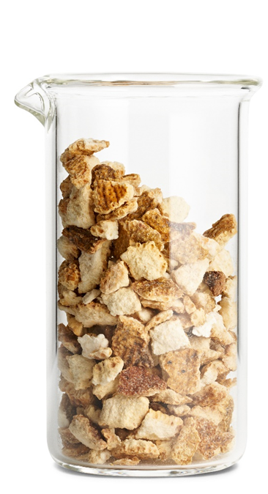
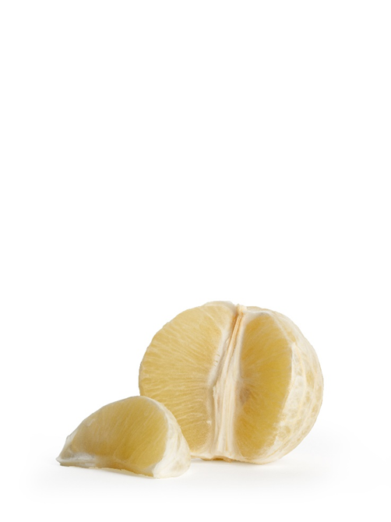
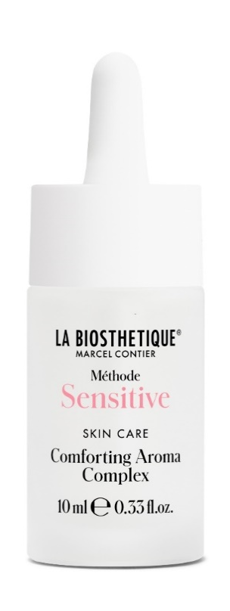
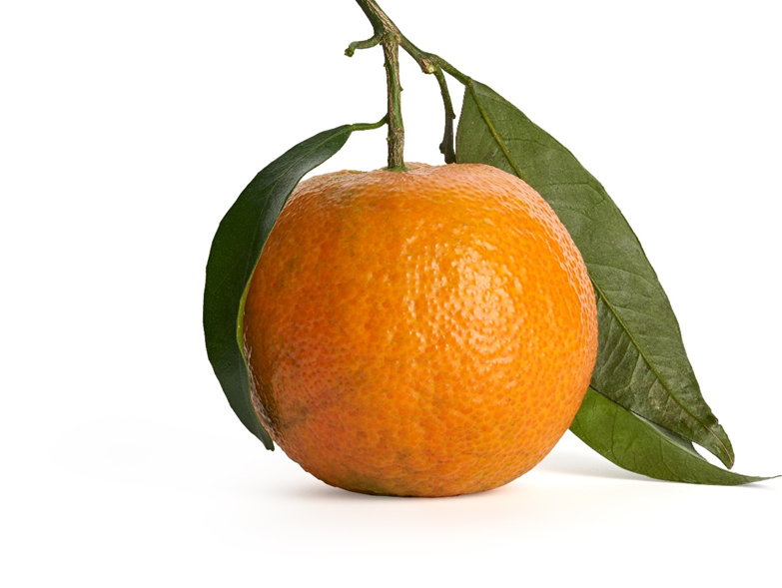
Comforting Aroma Oils
bitter orange
Anti-stress
for all irritated skin conditions
Bergamot
Tangerine
Notes:
Comforting Aroma oil
Antistress - care oil for all irritated skin conditions
Mandarin oil, bergamot fruit oil, bitter orange blossoms and leaves
Soothes irritated skin. Relaxes, astringent, ensures a balanced complexion
Effect through inhalation: Mood-enhancing, stress-relieving, the good mood aroma oil.

Slide 20


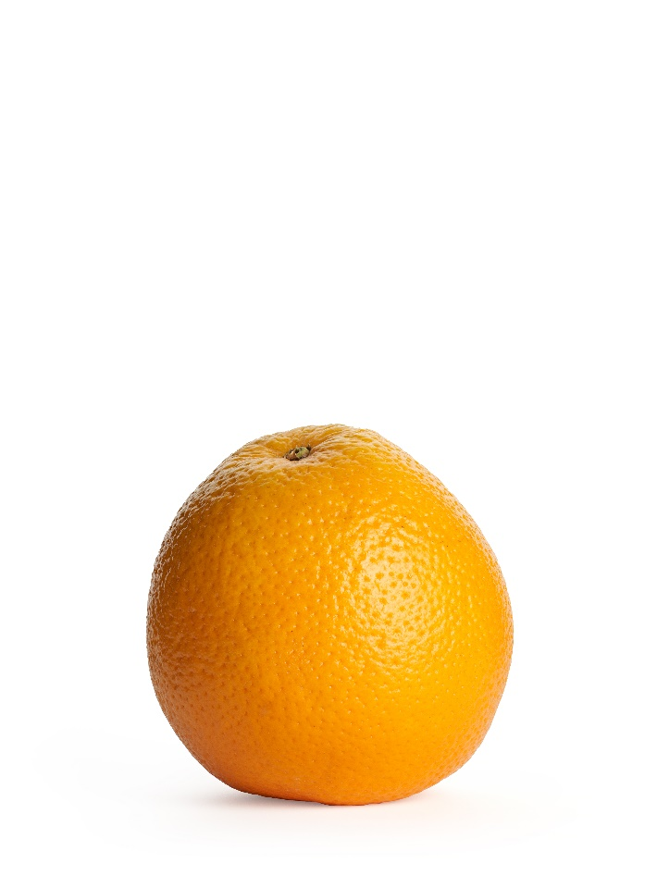
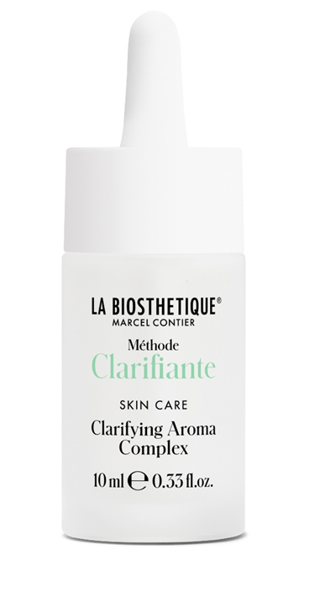
Clarifying Aroma Oils
Damask rose
Clarifying
for all skin conditions in need of detox
Orange/lemon
Bergamot
Notes:
Clarifying Aroma
Clarifying for clean facial skin
Damask rose, lemon peel oil, orange peel oil, bergamot have an antibacterial effect, purifying for oily skin, skin renewing, leave no greasy shine
Effect through inhalation: has a stress-relieving, mood-enhancing effect

Slide 21
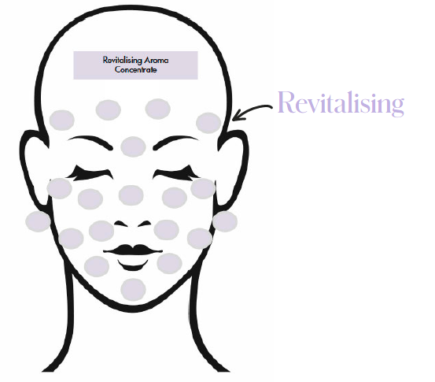
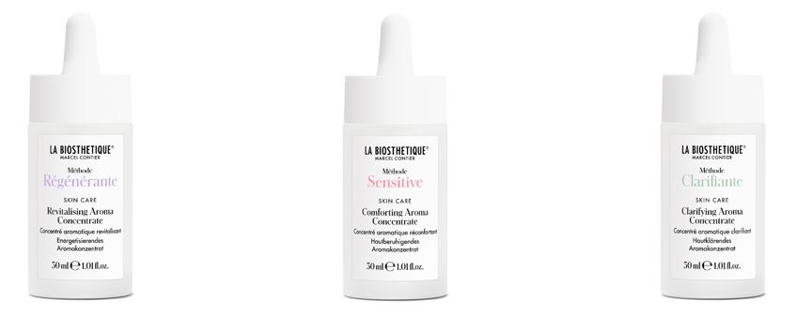
Aroma Concentrate with Zapel's
Aroma solution:
10 ml water + 1-5 drops Aroma Concentrate
Dip the Zapel‘s
Apply Zapel's
Notes:
What does Zapels mean? Zone d'application preferentielle. Preferred application zones.
Marcel Contier discovered the effective use of Zapels in the 1950s and it is experiencing renewed enthusiasm today because it is so playful and versatile to use.
As the Aroma Concentrates are hydrophilic and lipophilic, they can also work over make-up or cream. This means we can simply apply cones, even without cleansing the skin. The drawing is just an example. You can also place just 3 Detox Zapels on impurities or Cocooning Zapels on redness on the cheeks for a free Feel & Touch.
.

Slide 22
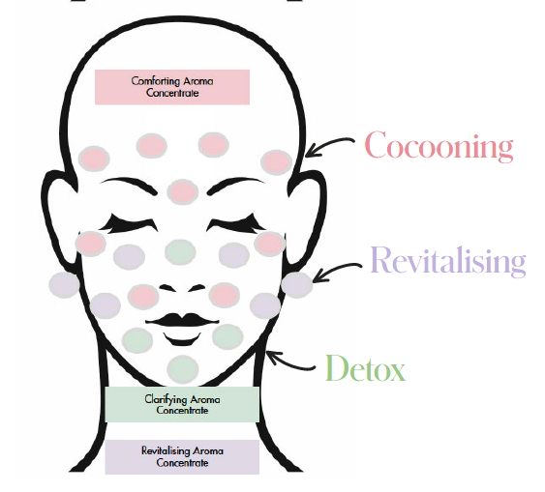
Aroma Concentrate with Zapel's
Aroma solution:
10 ml water + 1-5 drops Aroma Concentrate
Dip the Zapel‘s
Apply Zapel's
Notes:
When we do an Aroma Oil Beauty Express with Zapels, you can also apply 3 different Zapels as shown here. Relaxing on the redness and thinker's wrinkles and vitalising on tired skin areas and clarifying on the areas with impurities. This is what makes the Zapels treatment so unique.
How long do the Zapels stay on the skin?
3-5 minutes, but longer if you like, and as soon as they are dry, you should dip them back into the flavouring solution and apply them again. During the application time, you can perform a scalp ritual to give your client a holistic experience.

Slide 23
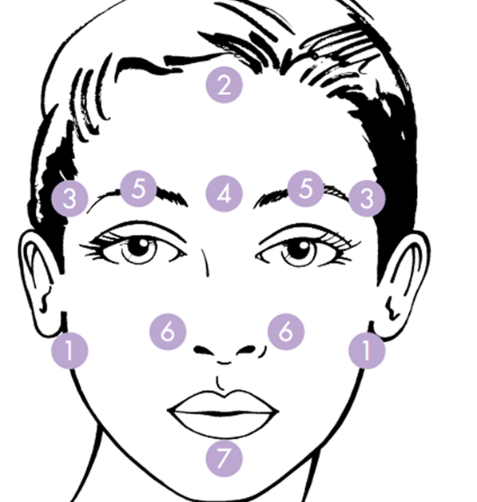
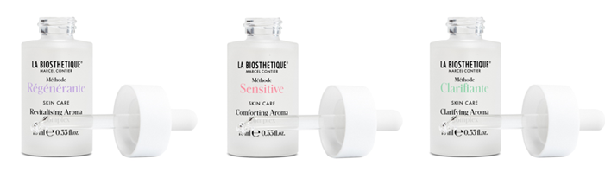
Aroma Complex at home
Notes:
The Aroma Complexes are particularly easy to use at home because they are ready to use. Simply apply to the face and enjoy the fragrance
C: or you can vitalise energy points with it. .
z. e.g. the forehead point for headaches, 4 centre of forehead - for more serenity, No. 3 for anger, 5 + 6 for tiredness, 1 and 7 for feelings of stress

